Slide 1
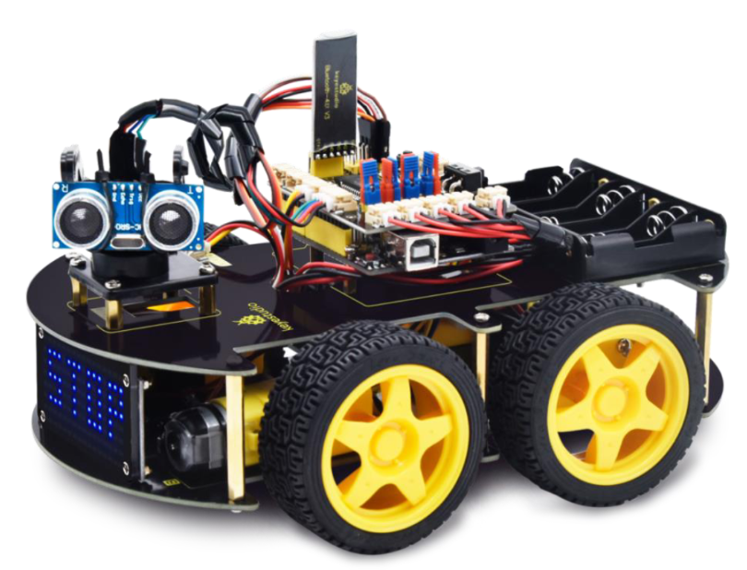
Summer Camp 2022
Nicholas Hinojosa
South Texas College

Slide 2




NICHOLAS HINOJOSA
South Texas College Computer Science Instructor (7+ years)
Associates of Mathematics
Bachelors in CIT
Masters in IT from UTPA
Certifications from Cisco (CCNA, CCENT)
Certification from SANS (GSEC)
Certification from CompTIA (Security+)
Certification from AWS
Certification from EC-Council (Certified Ethical Hacker)
Certificate from Google (Google IT Support Pro)
Programming I, II, III, C Programming
Survey of Programming, Advanced Web Design
Advanced Networking, Database Management
Internet/Internet Server Integration
Fundamentals of Information Security
Digital Forensics
Advanced Network Security

Slide 3
Multi-purpose Robot Car Kit (4 Wheels)
Smart Car using Arduino Uno Microcontroller
Follow Objects
Avoid Objects
Follow a Line
Infrared (IR) Remote Control
Smart Phone Control (Bluetooth)

Slide 4
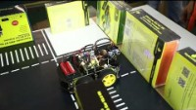

Slide 5
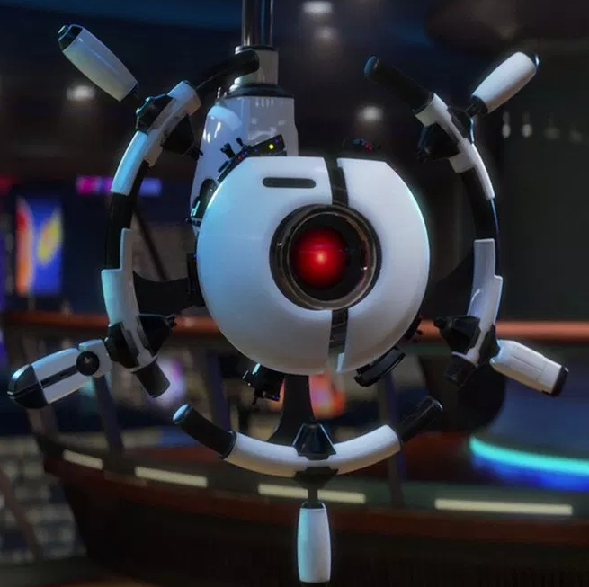
Tentative Schedule
Day 1 – Assemble Car
Day 2 – Wire Car and Test
Day 3 – Upload Programs to Car
Day 4 – TinkerCad Arduino Simulator
Day 5 – TinkerCad Arduino Simulator

Slide 6
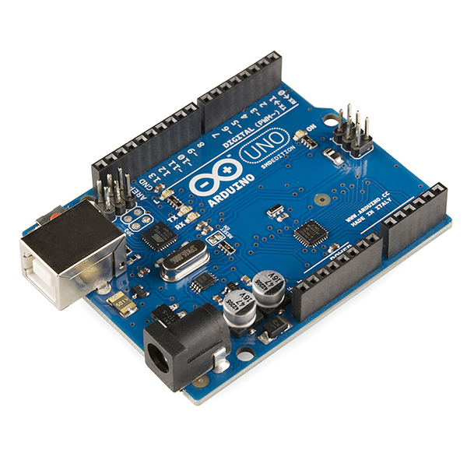
ABOUT SUMMER CAMP
Physically programmable microcontroller
Create electronic projects with hardware and software
Connects with input and output devices, such as ultrasonic distance, LEDs, motors, LCD screens, push buttons, temp sensors, phototransistors, etc.

Slide 7

GITHUB WEBSITE
https://github.com/nhinojosa/arduino-smart-car

Slide 8
What is electricity
Type of energy
Flows through conductors (wire)
electricity can turn on a light, noise from speaker, or move a motor
Circuits are closed loops of wire with a power source (battery)
There needs to be a complete path from the energy source (power +) to the point of least energy (ground - ) to make a circuit.

Slide 9
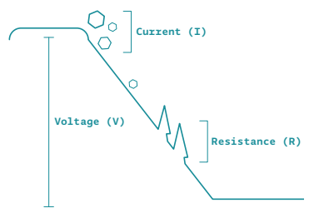
Parts of Electricity
Current – amount of electrical charge flowing past a specific point
Voltage – difference in energy from one point in a circuit and another
Resistance – how much a component resists flow of electricity

Slide 10
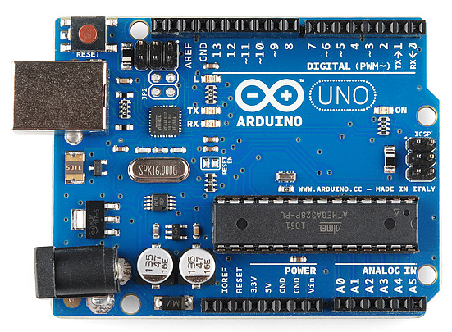
Arduino UNO
Power Connector
USB Port
Reset Button
Digital Pins
Pin 13 LED
Atmega Microcontroller
Power LED
GND and 5V Pins
Analog In Pins

Slide 11
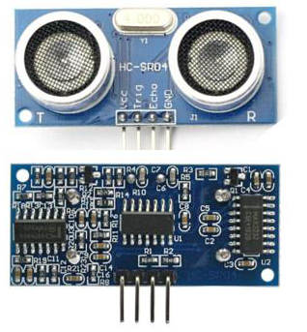
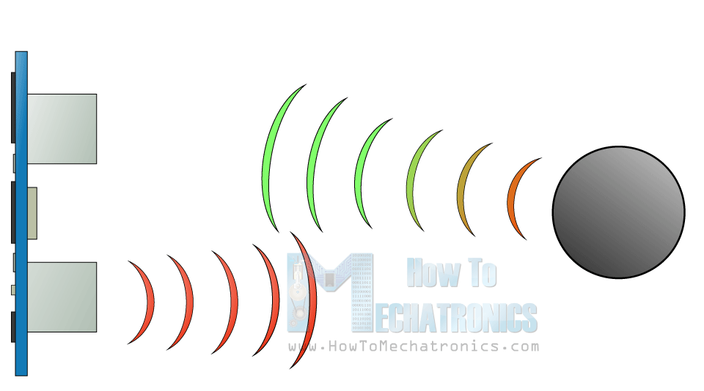
HC-SR04 ultrasonic sensor
The HC-SR04 ultrasonic sensor uses SONAR to determine the distance of an object just like a bat.
Accuracy range is 2 cm to 400 cm

Slide 12
How sonar works
A sonic burst is sent out
Travels at speed of sound and the sonic burst will bounce back from the object and it will be received
The speed of sound is 0.034 cm per microsecond
To get distance, the time received is multiplied by 0.034 and divided by 2

